Slide 1
Biological Modeling of Neural Networks
Week 4 – part 2: More Detail – compartmental models
4.2. Adding detail
- synapse
-cable equation
Week 4
– Reducing detail
- Adding detail
Wulfram Gerstner
EPFL, Lausanne, Switzerland

Slide 2
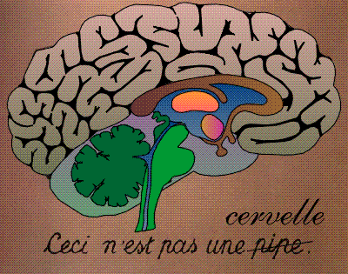
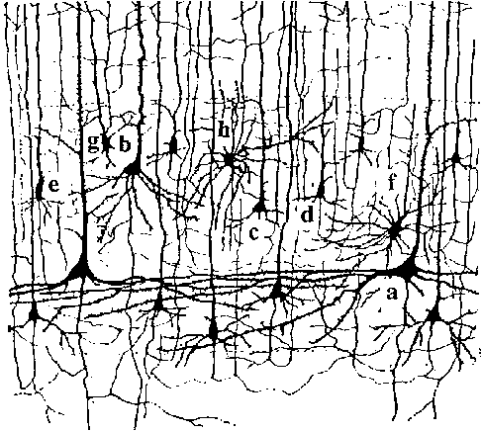
Neuronal Dynamics – 4.2. Neurons and Synapses
motor
cortex
frontal
cortex
to motor
output

Slide 3
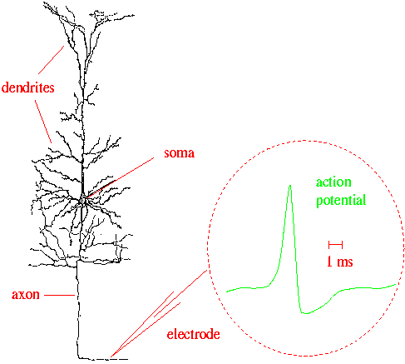
Neuronal Dynamics – 4.2 Neurons and Synapses
What happens
in a dendrite?
What happens
at a synapse?
action
potential
synapse
Ramon y Cajal

Slide 4
Neuronal Dynamics – 4.2. Synapses
Synapse

Slide 5
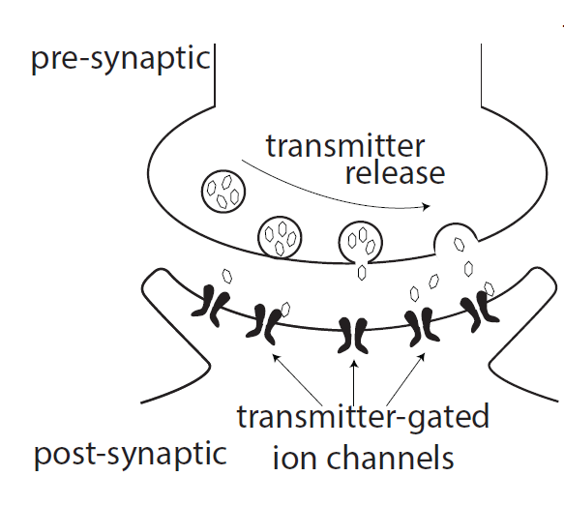
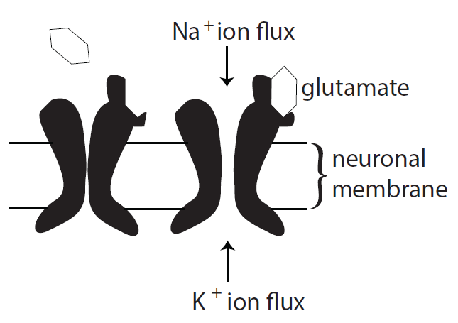
Neuronal Dynamics – 4.2 Synapses
glutamate: Important neurotransmitter at excitatory synapses
image: Neuronal Dynamics,
Cambridge Univ. Press

Slide 6
Neuronal Dynamics – 4.2. Synapses
glutamate: Important neurotransmitter at excitatory synapses
AMPA channel: rapid, calcium cannot pass if open
NMDA channel: slow, calcium can pass, if open
(N-methyl-D-aspartate)
GABA: Important neurotransmitter at inhibitory synapses
(gamma-aminobutyric acid)
Channel subtypes GABA-A and GABA-B

Slide 7
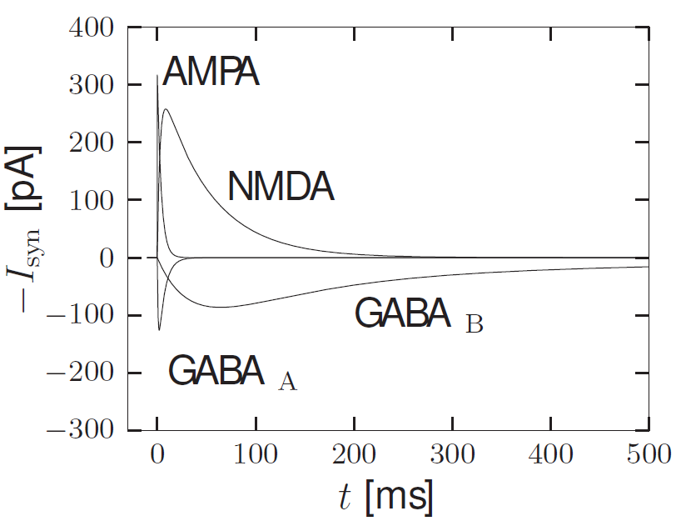
Neuronal Dynamics – 4.2. Synapse types
Model?
image: Neuronal Dynamics,
Cambridge Univ. Press

Slide 8
Neuronal Dynamics – 4.2. Synapse model
Model?
image: Neuronal Dynamics,
Cambridge Univ. Press

Slide 9
Neuronal Dynamics – 4.2. Synapse model
Model with rise time
image: Neuronal Dynamics,
Cambridge Univ. Press

Slide 10
Neuronal Dynamics – 4.2. Synaptic reversal potential
glutamate: excitatory synapses
GABA: inhibitory synapses

Slide 11
Neuronal Dynamics – 4.2. Synapses
glutamate: excitatory synapses
GABA: inhibitory synapses
Notes:
Habe ich nur sehr kurz machen koennen.

Slide 12
Neuronal Dynamics – 4.2.Synapses
Synapse

Slide 13
Neuronal Dynamics – Quiz 4.3
Multiple answers possible!
AMPA channel
[ ] AMPA channels are activated by AMPA
[ ] If an AMPA channel is open, AMPA can pass through the channel
[ ] If an AMPA channel is open, glutamate can pass through the channel
[ ] If an AMPA channel is open, potassium can pass through the channel
[ ] The AMPA channel is a transmitter-gated ion channel
[ ] AMPA channels are often found in a synapse
Synapse types
[ ] In the subthreshold regime, excitatory synapses always depolarize the
membrane, i.e., shift the membrane potential to more positive values
[ ] In the subthreshold regime, inhibitory synapses always hyperpolarize the
membranel, i.e., shift the membrane potential more negative values
[ ] Excitatory synapses in cortex often contain AMPA receptors
[ ] Excitatory synapses in cortex often contain NMDA receptors

Slide 14
Biological Modeling of Neural Networks
Week 4 – part 2: More Detail – compartmental models
3.1 From Hodgkin-Huxley to 2D
3.2 Phase Plane Analysis
3.3 Analysis of a 2D Neuron Model
4.1 Type I and II Neuron Models
- limit cycles
- where is the firing threshold?
- separation of time scales
4.2. Dendrites
- synapses
-cable equation
Week 4
– Reducing detail
- Adding detail
Wulfram Gerstner
EPFL, Lausanne, Switzerland

Slide 15
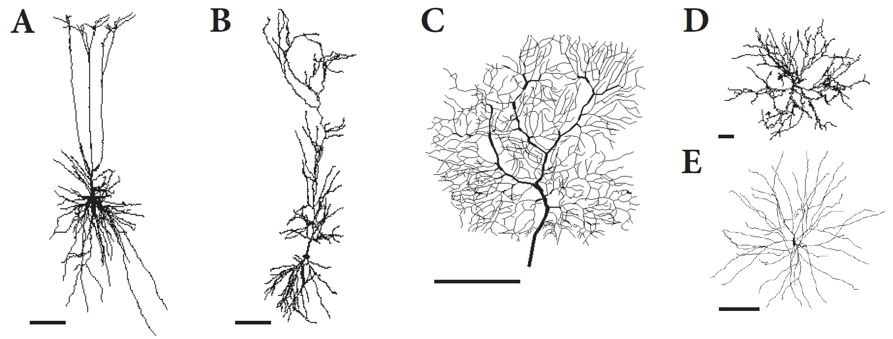
Neuronal Dynamics – 4.2. Dendrites

Slide 16
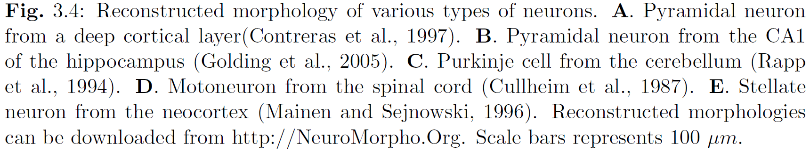
Neuronal Dynamics – 4.2 Dendrites

Slide 17
Neuronal Dynamics – Review: Biophysics of neurons
Cell surrounded by membrane
Membrane contains
- ion channels
- ion pumps
Dendrite and axon:
Cable-like extensions
Tree-like structure
-70mV
soma
Na⁺
action
potential
K⁺
Ca²⁺
Ions/proteins

Slide 18
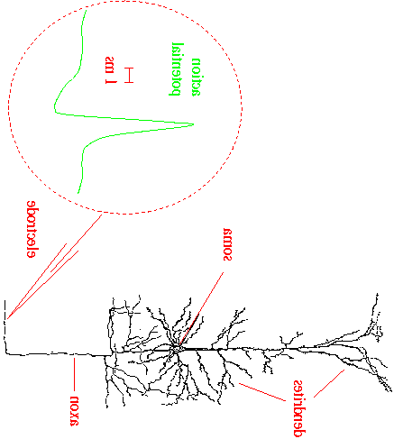

ndrites.
Neuronal Dynamics – Modeling the Dendrite
soma
Dendrite
Longitudinal
Resistance RL
I
I
C
g_{ion}
C
g_{l}
g_{l}

Slide 19
ndrites.
Neuronal Dynamics – Modeling the Dendrite
soma
Dendrite
Longitudinal
Resistance RL
I
I
C
g_{ion}
C
Calculation

Slide 20
ndrites.
Neuronal Dynamics – Conservation of current
soma
Dendrite
RL
I
I
C
g_{ion}
C

Slide 21
Neuronal Dynamics – 4.2 Equation-Coupled compartments
Basis for
Cable equation
-Compartmental models
I
I
C
g_{ion}
C
Notes:
The equation which we have just derived, is central for the description of
Electric current flow in dendrites.
It is the basis for the compartmental models that we will see in the last lecture of this week.
But it is also the basis for the cable equation. The derivation of the cable equation
is the topic of the next part. Please stay on! The lecture continues!

Slide 22
Neuronal Dynamics – 4.2 Derivation of Cable Equation
I
I
C
g_{ion}
C
mathemetical derivation, now
Notes:
Welcome back to the continuation of Lecture 3. The discussion stopped with an equation
That describes the electrical properties of a small segment of a dendrite.
The definition of the segments involved some arbitrary choice of the segment size.
We would like now to get rid of this arbitrary choice. CLICK! To do so, we
take the continuum limit and derive the so-called cable equation shown at the bottom of this slide

Slide 23
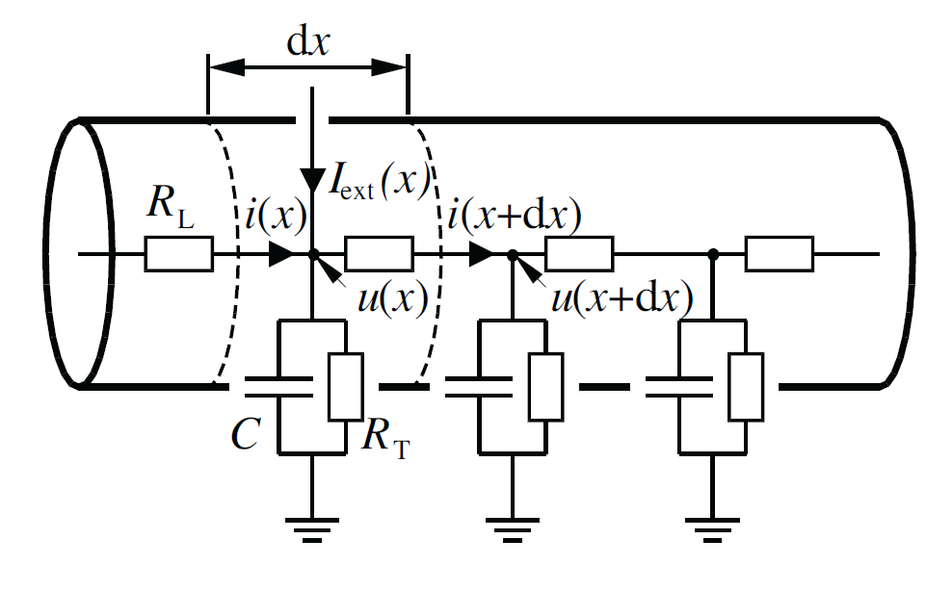
Neuronal Dynamics – 4.2 Modeling the Dendrite
gion
g

Slide 24
Neuronal Dynamics – 4.2 Derivation of cable equation

Slide 25
Neuronal Dynamics – 4.2 Dendrite as a cable
passive dendrite
active dendrite
axon

Slide 26
Neuronal Dynamics – Quiz 4.4
Multiple answers possible!
Scaling of parameters.
Suppose the ionic currents through the membrane are well approximated by a simple leak current. For a dendritic segment of size dx, the leak current is through the membrane characterized by a membrane resistance R. If we change the size of the segment
From dx to 2dx
[ ] the resistance R needs to be changed from R to 2R.
[ ] the resistance R needs to be changed from R to R/2.
[ ] R does not change.
[ ] the membrane conductance increases by a factor of 2.

Slide 27
ndrites.
Neuronal Dynamics – 4.2. Cable equation
soma
Dendrite
RL
I
I
C
g_{ion}
C

Slide 28
Neuronal Dynamics – 4.2 Cable equation
passive dendrite
active dendrite
axon

Slide 29
Neuronal Dynamics – 4.2 Cable equation
Mathematical derivation
passive dendrite
active dendrite
axon

Slide 30
Neuronal Dynamics – 4.2 Derivation for passive cable
passive dendrite
See exercise 3

Slide 31
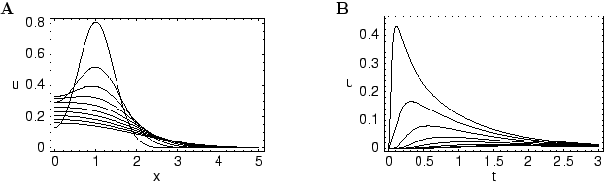
ndrites.
Neuronal Dynamics – 4.2 dendritic stimulation
soma
passive dendrite/passive cable
Stimulate dendrite, measure at soma

Slide 32
ndrites.
Neuronal Dynamics – 4.2 dendritic stimulation
soma
The END

Slide 33
Neuronal Dynamics – Quiz 4.5
Multiple answers possible!
The space constant of a
passive cable is
[ ]
[ ]
[ ]
[ ]
Dendritic current injection.
If a short current pulse is injected into the dendrite
[ ] the voltage at the injection site is maximal immediately after the end of the injection
[ ] the voltage at the dendritic injection site is maximal a few milliseconds after the end of the injection
[ ] the voltage at the soma is maximal immediately after the end of the injection.
[ ] the voltage at the soma is maximal a few milliseconds after the end of the injection
It follows from the cable equation that
[ ] the shape of an EPSP depends on the dendritic location of the synapse.
[ ] the shape of an EPSP depends only on the synaptic time constant, but not on dendritic location.

Slide 34
Neuronal Dynamics – Homework
Consider
(*)
(i) Take the second derivative of (*) with respect to x. The result is
(ii) Take the derivative of (*) with respect to t. The result is
(iii) Therefore the equation is a solution to
with
(iv) The input current is [ ]
[ ]

Slide 35
Neuronal Dynamics – Homework
Consider the two equations
(1)
(2)
The two equations are equivalent under the transform
with constants c= ….. and a = …..

Slide 36
ndrites.
Neuronal Dynamics – 4.3. Compartmental models
soma
dendrite
RL
I
I
C
g_{ion}
C

Slide 37
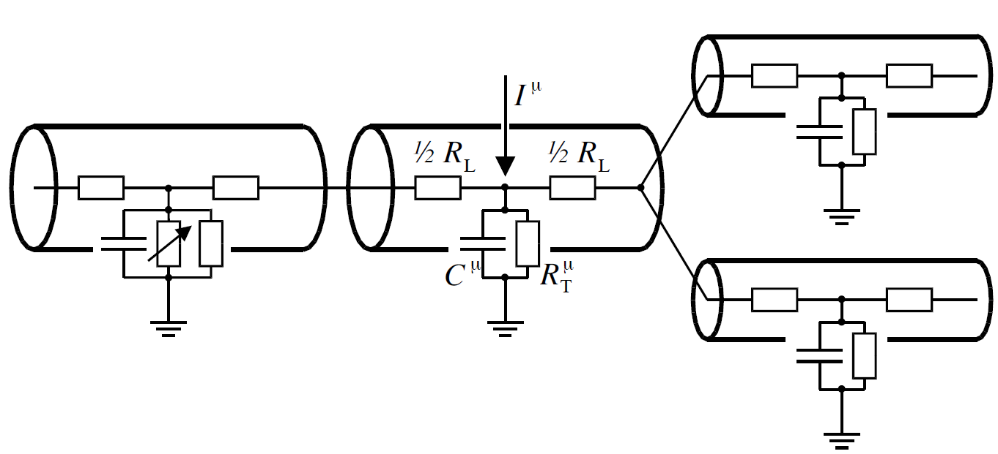
ndrites.
Neuronal Dynamics – 4.3. Compartmental models
Software tools: - NEURON (Carnevale&Hines, 2006)
- GENESIS (Bower&Beeman, 1995)

Slide 38
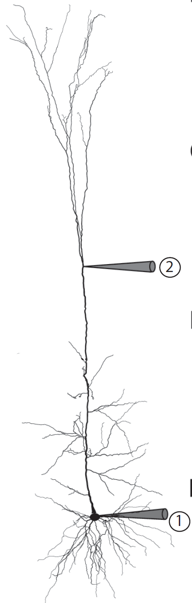
ndrites.
Neuronal Dynamics – 4.3. Model of Hay et al. (2011)
Morphological reconstruction
Branching points
200 compartments
-spatial distribution of ion currents
Sodium current (2 types)
- HH-type (inactivating)
- persistent (non-inactivating)
Calcium current (2 types and calcium pump)
Potassium currents (3 types, includes )
Unspecific current
‘hotspot’
Ca currents
layer 5 pyramidal cell

Slide 39
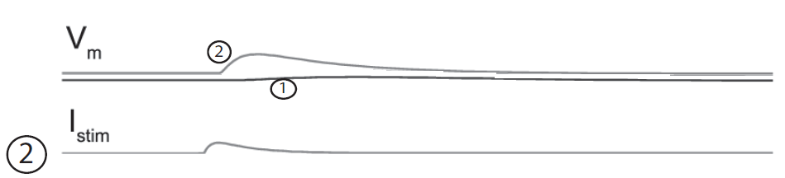
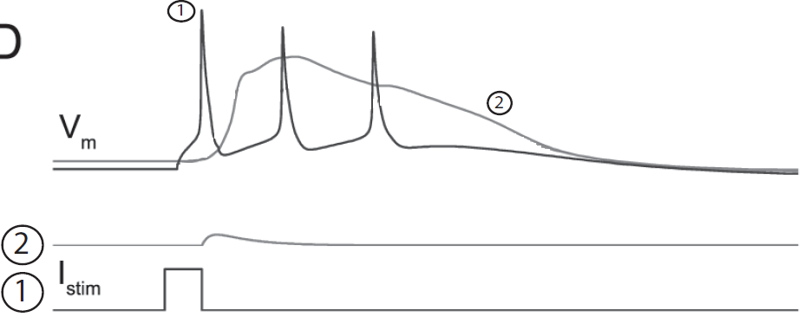
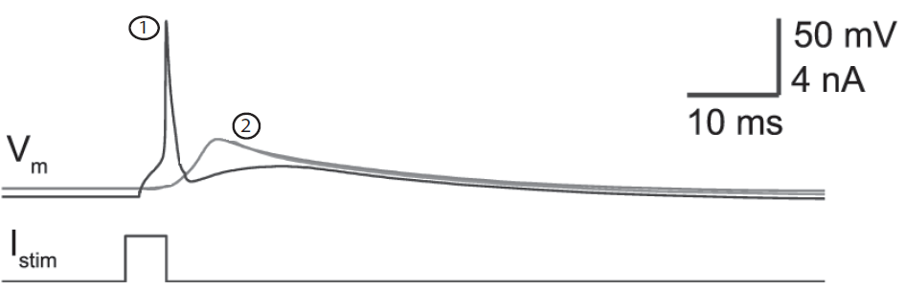
Neuronal Dynamics – 4.3. Active dendrites: Model
Hay et al. 2011,
PLOS Comput. Biol.

Slide 40
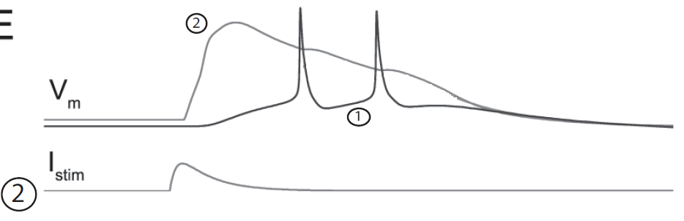
Neuronal Dynamics – 4.3. Active dendrites: Model
Hay et al. 2011,
PLOS Comput. Biol.

Slide 41
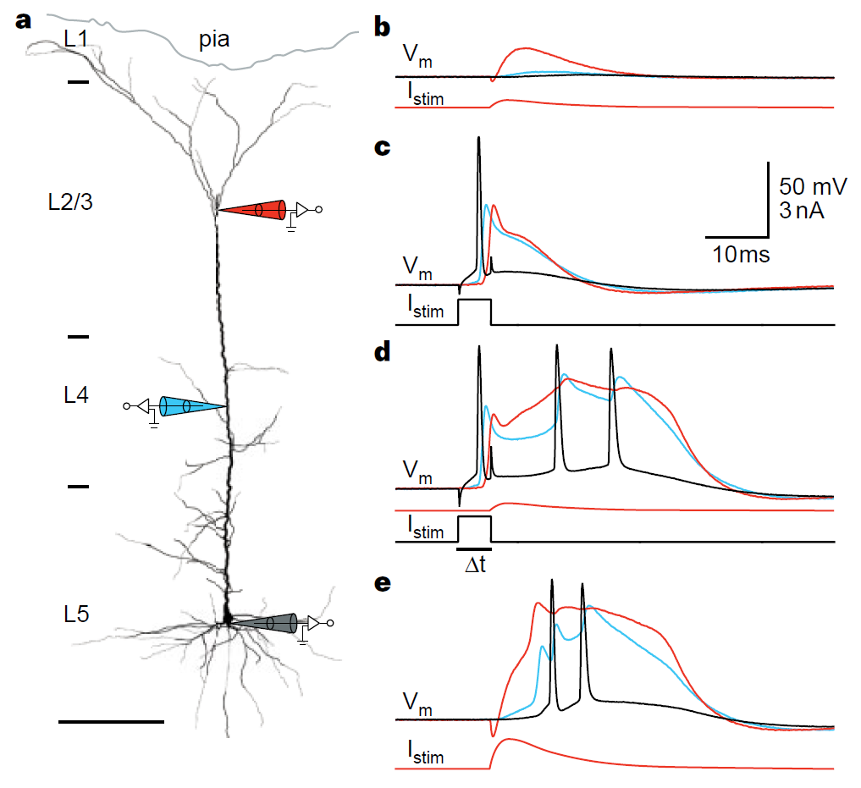
Neuronal Dynamics – 4.3. Active dendrites: Experiments
BPAP:
backpropagating action potential
Dendritic Ca spike:
activation of Ca channels
Ping-Pong:
BPAP and Ca spike
Larkum, Zhu, Sakman
Nature 1999
Notes:
Use pen to show direction of BPAP and Ca spike

Slide 42
Neuronal Dynamics – 4.3. Compartmental models
Dendrites are more than passive filters.
Hotspots
BPAPs
Ca spikes
Compartmental models
- can include many ion channels
- spatially distributed
- morphologically reconstructed
BUT
- spatial distribution of ion channels
difficult to tune

Slide 43
Neuronal Dynamics – Quiz 4.5
Multiple answers possible!
BPAP
[ ] is an acronym for BackPropagatingActionPotential
[ ] exists in a passive dendrite
[ ] travels from the dendritic hotspot to the soma
[ ] travels from the soma along the dendrite
[ ] has the same duration as the somatic action potential
Dendritic Calcium spikes
[ ] can be induced by weak dendritic stimulation
[ ] can be induced by strong dendritic stimulation
[ ] can be induced by weak dendritic stimulation combined with a BPAP
[ ] can only be induced be strong dendritic stimulation combined with a BPAP
[ ] travels from the dendritic hotspot to the soma
[ ] travels from the soma along the dendrite

Slide 44
Neuronal Dynamics – week 4 – Reading
Reading: W. Gerstner, W.M. Kistler, R. Naud and L. Paninski,
Neuronal Dynamics: from single neurons to networks and
models of cognition. Chapter 3: Dendrites and Synapses, Cambridge Univ. Press, 2014
OR W. Gerstner and W. M. Kistler, Spiking Neuron Models, Chapter 2, Cambridge, 2002
OR P. Dayan and L. Abbott, Theoretical Neuroscience, Chapter 6, MIT Press 2001
References:
M. Larkum, J.J. Zhu, B. Sakmann (1999), A new cellular mechanism for coupling inputs arriving at different cortical layers, Nature, 398:338-341
E. Hay et al. (2011) Models of Neocortical Layer 5b Pyramidal Cells Capturing a Wide Range of Dendritic and Perisomatic Active Properties, PLOS Comput. Biol. 7:7
Carnevale, N. and Hines, M. (2006). The Neuron Book. Cambridge University Press.
Bower, J. M. and Beeman, D. (1995). The book of Genesis. Springer, New York.
Rall, W. (1989). Cable theory for dendritic neurons. In Koch, C. and Segev, I., editors, Methods in
Neuronal Modeling, pages 9{62, Cambridge. MIT Press.
Abbott, L. F., Varela, J. A., Sen, K., and Nelson, S. B. (1997). Synaptic depression and cortical gain control. Science 275, 220–224.
Tsodyks, M., Pawelzik, K., and Markram, H. (1998). Neural networks with dynamic synapses. Neural. Comput. 10, 821–835.

Slide 45
Neuronal Dynamics: Computational Neuroscience of Single Neurons
Week 3 – part 2: Synaptic short-term plasticity
3.1 Synapses
3.2 Short-term plasticity
3.3 Dendrite as a Cable
3.4 Cable equation
3.5 Compartmental Models
- active dendrites
Week 3 – Adding Detail:
Dendrites and Synapses
Wulfram Gerstner
EPFL, Lausanne, Switzerland

Slide 46
Week 3 – part 2: Synaptic Short-Term plasticity
3.1 Synapses
3.2 Short-term plasticity
3.3 Dendrite as a Cable
3.4 Cable equation
3.5 Compartmental Models
- active dendrites

Slide 47
Neuronal Dynamics – 3.2 Synaptic Short-Term Plasticity
pre
post
i
j

Slide 48
Neuronal Dynamics – 3.2 Synaptic Short-Term Plasticity
Short-term plasticity/
fast synaptic dynamics
Thomson et al. 1993
Markram et al 1998
Tsodyks and Markram 1997
Abbott et al. 1997
pre
post
i
j

Slide 49
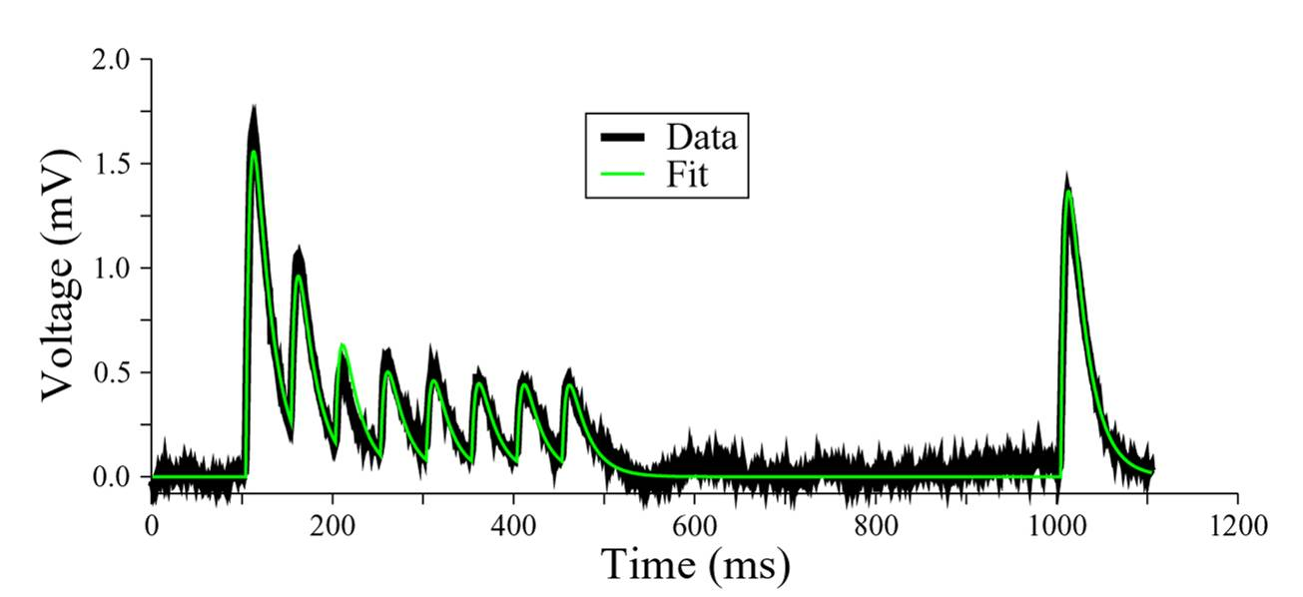
Neuronal Dynamics – 3.2 Synaptic Short-Term Plasticity
+50ms
20Hz
pre j
post
i
Changes
- induced over 0.5 sec
- recover over 1 sec
Courtesy M.J.E Richardson
Data: G. Silberberg, H.Markram
Fit: M.J.E. Richardson (Tsodyks-Pawelzik-Markram model)

Slide 50
Neuronal Dynamics – 3.2 Model of Short-Term Plasticity
Dayan and Abbott,
2001
Fraction of filled release sites
Synaptic conductance
image: Neuronal Dynamics,
Cambridge Univ. Press

Slide 51
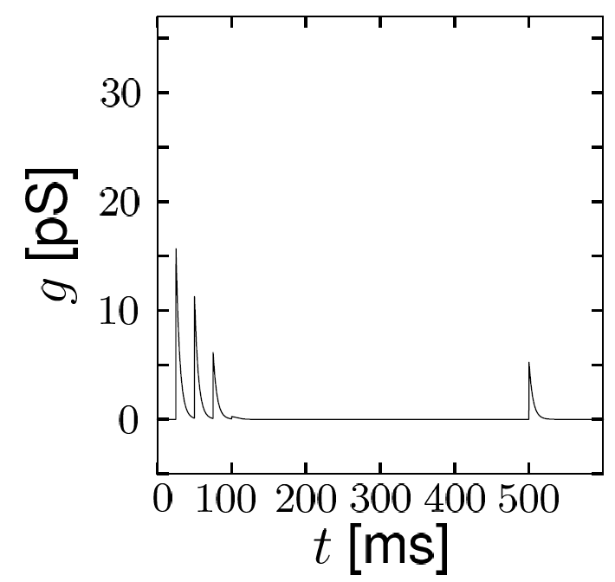
Neuronal Dynamics – 3.2 Model of synaptic depression
4 + 1 pulses
Fraction of filled release sites
Synaptic conductance
image: Neuronal Dynamics,
Cambridge Univ. Press
Dayan and Abbott, 2001

Slide 52
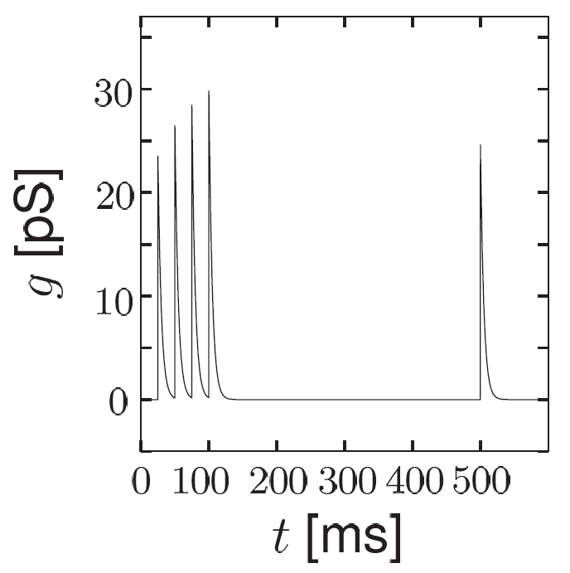
Neuronal Dynamics – 3.2 Model of synaptic facilitation
4 + 1 pulses
Fraction of filled release sites
Synaptic conductance
image: Neuronal Dynamics,
Cambridge Univ. Press
Dayan and Abbott, 2001

Slide 53
Neuronal Dynamics – 3.2 Summary
pre
post
j
i
Synapses are not constant
Depression
Facilitation
Models are available
Tsodyks-Pawelzik-Markram 1997
Dayan-Abbott 2001

Slide 54
Neuronal Dynamics – Quiz 3.2
Multiple answers possible!
Time scales of Synaptic dynamics
[ ] The rise time of a synapse can be in the range of a few ms.
[ ] The decay time of a synapse can be in the range of few ms.
[ ] The decay time of a synapse can be in the range of few hundred ms.
[ ] The depression time of a synapse can be in the range of a few hundred ms.
[ ] The facilitation time of a synapse can be in the range of a few hundred ms.
Synaptic dynamics and membrane dynamics.
Consider the equation
With a suitable interpretation of the variable x and the constant c
[ ] Eq. (*) describes a passive membrane voltage u(t) driven by spike arrivals.
[ ] Eq. (*) describes the conductance g(t) of a simple synapse model.
[ ] Eq. (*) describes the maximum conductance of a facilitating synapse

Slide 55
Neuronal Dynamics – 3.2 Literature/short-term plasticity
Dayan, P. and Abbott, L. F. (2001). Theoretical Neuroscience. MIT Press, Cambridge.
Abbott, L. F., Varela, J. A., Sen, K., and Nelson, S. B. (1997). Synaptic depression and cortical gain control. Science 275, 220–224.
Markram, H., and Tsodyks, M. (1996a). Redistribution of synaptic efficacy between neocortical pyramidal neurons. Nature 382, 807–810.
A.M. Thomson, Facilitation, augmentation and potentiation at central synapses,
Trends in Neurosciences, 23: 305–312 ,2001
Tsodyks, M., Pawelzik, K., and Markram, H. (1998). Neural networks with dynamic synapses. Neural. Comput. 10, 821–835.

